Slide 1
BASIC LINUX COMMANDS
# pwd (present working directory)
# cd (change directory)
# ls (to view content list)
# ls -l (to view detail list)
# ls -la (to show all file or folder)
# mkdir /test (for creating folder,here test is a folder)
# touch file{1,2} (for creating file)
# cd . (present working directory)
# cd .. (previous working directory)
# mkdir /test (absolute path)
# mkdir test (relative path)

Slide 2
BASIC LINUX COMMANDS
# (Esc):wq (for coming out from any file)
# useradd username (to create an user)
# passwd username (to give password for that user)
# finger username (to know info about user)
# rm -f filename (to delete a file)
# id -a username (to know user id & group id)
# groupadd groupname
# :set number (firstly press esc) (for show the file line)

Slide 3
BASIC LINUX COMMANDS
# cp source destination (to copy something)
# userdel -r username (to delete user)
# userdel -rf username (to delete user forcefully)
# hostname (to know host)
# df -h (to see partition)
# fdisk -l (to see device & partition
# setup (different type of configuration)
# ifconfig (to know ip)
# yum install packagename* -y (to install any package)
# init 6 (System restart)
# init 0 (System shutdown)

Slide 4
Linux Filesystem Management
Linux Commands
badblocks Used to search a disk or partition for badblocks. (badblocks device) (badblocks hda)
df Shows the disk free space on one or more filesystems. (df –k, df -h)
du Shows how much disk space a directory and all its files contain. (du <directory>, du –sk <directory>, du –sh <directory>)
fsck Filesystem check. Must not be run on a mounted file system. (fsck <filesystem>)

Slide 5
Linux Filesystem Management
Linux Commands
sync Synchronize data on disk with memory. `sync' writes any data buffered in memory out to disk.
mount Used to mount a filesystem. Complement is umount. (mount <filesystem>, mount –a)
umount Unmounts a filesystem. Complement is mount. (umount <filesystem>)

Slide 6
Network Management Commands
Linux Commands
dnsdomainname Show the systems DNS domain name
hostname Used to show or set the name of your machine for networking
nisdomainname Show or set systems NIS/YP domain name
ypdomainname Show or set the system's NIS/YP domain name

Slide 7
Network Management Commands
Linux Commands
arp This program lets the user read or modify their arp cache.
dig Send domain name query packets to name servers for debugging or testing.
finger Display information about the system users. Ex: finger Deepak
ftp File transfer program. (ftp <remote system name/ip)
ifconfig Configure a network interface. Ex:
ifconfig eth0 address 172.31.2.2 netmask 255.255.0.0
ifdown Shutdown a network interface. Ex: ifdown eth0
ifup Brings a network interface up. Ex: ifup eth0

Slide 8
Network Management Commands
Linux Commands
netconf A GUI interactive program to let you configure a network on Redhat systems.
netconfig Another GUI step by step network configuration program.
netstat Displays information about the systems network connections, including port connections, routing tables, and more. The command "netstar -r" will display the routing table. (netsat –rn)
nslookup Used to query DNS servers for information about hosts.

Slide 9
Network Management Commands
Linux Commands
ping Send ICMP ECHO_REQUEST packets to network hosts. (ping <remote-host-name/ip)
route Show or manipulate the IP routing table. (route, route add, route del)
showmount Show mount information for an NFS server.
ssh Secure Login (ssh <remote system name/ip>)

Slide 10
Network Management Commands
Linux Commands
tcpdump Dump traffic on a network. Prints out headers of packets that match the boolean expression. (tcpdump eth0)
telnet User interface to the TELNET protocol, setting up a remote console session. (telnet <remote system name/ip>)
traceroute Print the route that packets take to the specified network host. (traceroute <remote system name/ip>)

Slide 11
Network Management Commands
Linux Commands
Communications commands (includes mail)
elm Electronic mail.
pine Program for internet news and e-mail, Can send documents, graphics, local & remote messages.
talk Lets two parties talk simultaneously.
mail To send a mail

Slide 12
System Management Commands
Linux Commands
Runtime level management
exit Terminates the shell.
halt Stop the system.
init Process control initialization. (init 3)
logout Log the user off the system.
poweroff Brings the system down.
reboot Reboot the system.
runlevel List the current and previous runlevel.

Slide 13
System Management Commands
Linux Commands
shutdown If your system has many users, use the command shutdown -h +time ‘<message>`, where time is the time in minutes until the system is halted, and message is a short explanation of why the system is shutting down.
Ex: # shutdown -h +10 'We will install a new disk. System should be back on-line in three hours.‘

Slide 14
System Management Commands
Linux Commands
passwd Set a user's pass word. (passwd, passwd <username>)
quota Display users' limits and current disk usage. (quota, quota <username>)
quotaoff Turns filesystem quotas off.
quotaon Turns filesystem quotas on.
quotacheck Used to check a filesystem for usage, and update the quota.user file.
edquota Used to edit user or group quotas. (edquota <username>)

Slide 15
System Management Commands
Linux Commands
su Single user login. (su -)
useradd Create a new user or update default new user information. (useradd –g <group> -s <shell> -c <comment> –d <home directory> <username>
userdel Delete a user account and related files. (userdel <user name>)
usermod Modify a user account.
users Print the user names of users currently logged in.
wall Send a message to everybody's terminal. (wall “text message”)
who Display the users logged in.
whoami Print effective user id.

Slide 16
System Management Commands
Linux Commands
System Time
cal Calendar. (cal, cal 2005)
date Print or set the system date and time. (date, date MMDDhhmm[[CC]YY][.ss])
hwclock Set or read the hardware CMOS clock.
uptime Reports how long the system has been running.

Slide 17
Linux Job & Process Management
Linux Commands
Linux Process Management
ps Get the status of one or more processes.
PPID-parent process ID ; PID-process ID
Eg: ps ax |more to see all processes including daemons
Eg : ps –ef | grep <process>
pstree Display the tree of running processes.
pgrep looks through the currently running processes and lists the process IDs which matches the selection criteria to stdout.All the criteria have to match.
top The top program provides a dynamic real-time view of a running system. It can display system summary information as well as a list of tasks currently being managed by the Linux kernel

Slide 18
Linux Job & Process Management
Linux Commands
Linux Process Management
bg Starts a suspended process in the background
fg Starts a suspended process in the foreground
kill Ex: "kill 34" - Effect: Kill or stop the process with the process ID number 34.
killall Kill processes by name. Can check for and restart processes.
pid Find the process ID of a running program

Slide 19
Linux Network Configuration
Linux System Administration
/etc/resolv.conf Tells the kernel which name server should be queried when a program asks to "resolve" an IP Address.
nameserver 172.31.1.1
search cc.iitk.ac.in iitk.ac.in
/etc/sysconfig/network Indicates networking is enabled (NETWORKING=yes) and provides information on hostname, gateway and nis domain.
NETWORKING=yes
HOSTNAME=webhome.cc.iitk.ac.in
NISDOMAIN=cc
GATEWAY=172.31.1.250

Slide 20
Linux Network Configuration
Linux System Administration
/etc/sysconfig/network-scripts/ifcfg-eth0 Network configurations like boot protocol (static/dhcp), ip address, netmask, network address, broadcast address etc.
DEVICE=eth0
ONBOOT=yes
BOOTPROTO=static
IPADDR=172.31.1.40
NETMASK=255.255.0.0
BROADCAST=172.31.255.255
NETWORK=172.31.0.0
GATEWAY=172.31.1.250

Slide 21
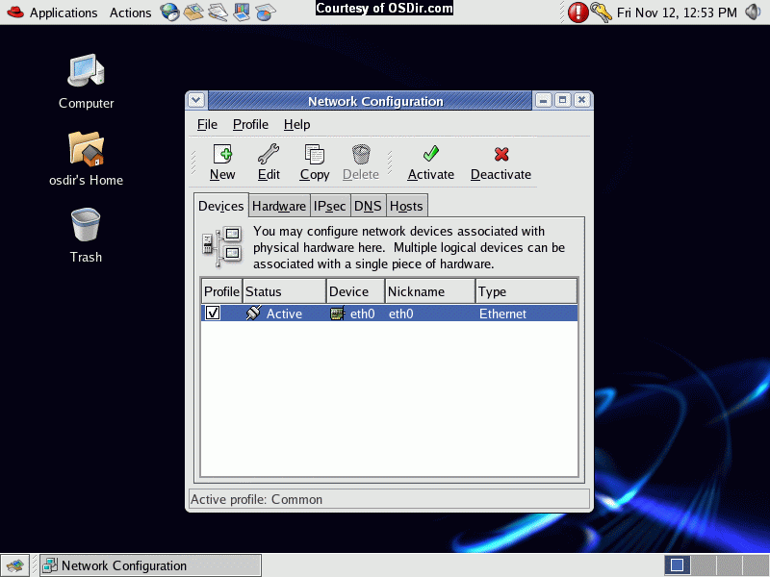

Slide 22
Scheduling Jobs: Cron
Linux System Administration
Cron is a program that enables you to execute a command, or a script with a sequence of commands, at a specified date, time or at set intervals.
Add the job script in /etc/cron.hourly or /etc/cron.daily or /etc/cron.weekly or /etc/cron.monthly to schedule a job

Slide 23
Scheduling Jobs: Cron
Linux System Administration
Make an entry in /etc/crontab file to schedule a job (crontab -e) the format is
* * * * * command_to_execute
each star denotes Minute Hour Day_of_Month Month Day_of_Week
Minute = Minute of the hour, 00 to 59. * Will indicate every minute
Hour = Hour of the day in 24-hour format, 00 to 23. * Will indicate every hour
Day = Day of the month, 1 to 31. * Will indicate every day
Month = Month of the year, 1 to 12. * Will indicate every month
Day = Day of the week, 3 chars - sun, mon, tue, or numeric (0=sun, 1=mon etc).... * Will indicate every day
Task = The command you want to execute

Slide 24
Backup & Restore
Linux System Administration
Backup the user area or configuration file
Use tar to take backup on a different disk or tape
Backup can be scheduled using cron
Backup: tar –zcvf <tar filename> <Directory Tree to be backedup>
Restore: tar –zxvf <tar filename> <file to be recovered>
Backup should be occasionally checked by restoring it
Backup Policy: Full Backup every weekly/fortnightly and incremental backup every day

Slide 25
Adding & Removing Software
Linux System Administration
Download a binary
Download the source code and compile on the system (download, untar, configure, make, make install, make uninstall)
Use RPM - Redhat Package Manager and install rpms
www.rpmseek.com & www.rpmfind.net can be used to search and download rpms (i386 Binary RPMs or SRC RPMs)
For Binary rpms: rpm [options] rpm-file
(rpm –qa, rpm –ivh, rpm –Uvh, rpm -e)
Where -q= query, -a= all, -i=install, -v=verbrose, -U= upgrade, -h= hash, -e= erase
For Source rpms: rpmbuild –rebuild rpm-source-file
Compiled binary rpms will be available at /usr/src/redhat/RPMS/i386 which can be installed

Slide 26
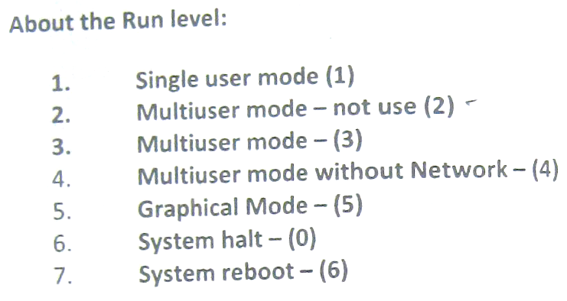

Slide 27
Thank You

